Slide 1

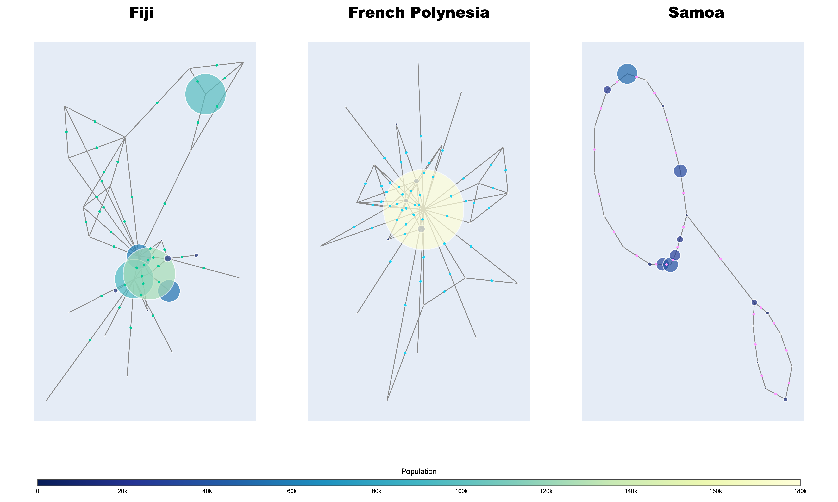
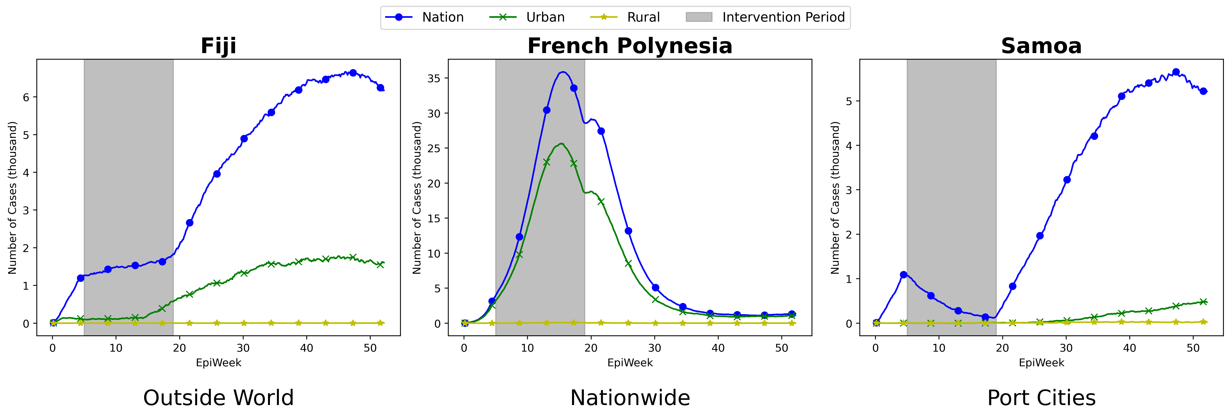
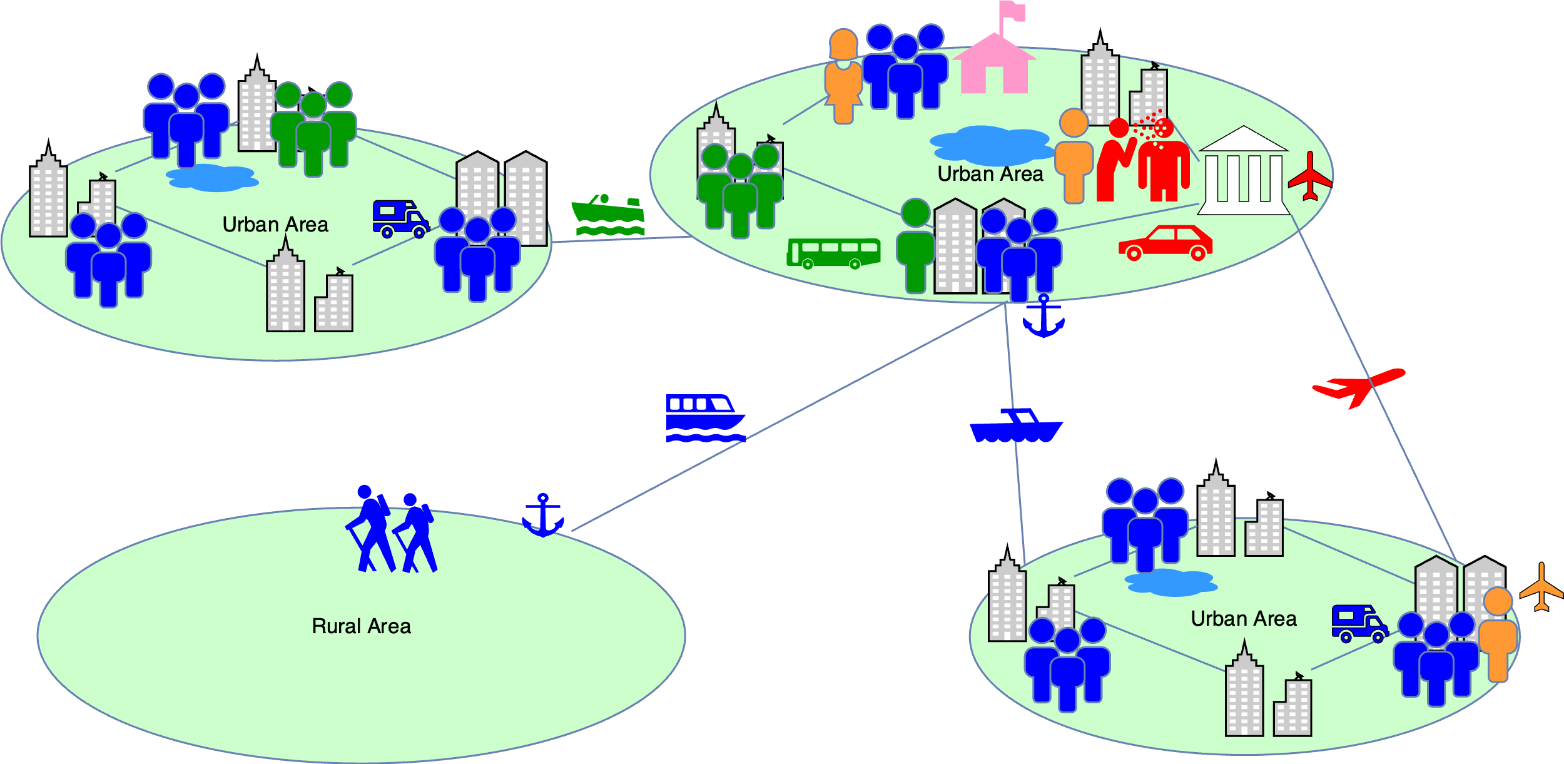
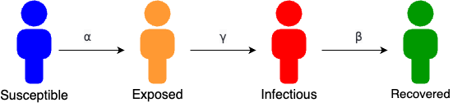







Travel network analysis for infectious disease transmission in Pacific Island countries
TMV2
Hongen Lu¹, Ce Hou¹², Viviana Angel Torres², Huey Fee Lim², Colleen L Lau¹, Luis Furuya-Kanamori¹, Adam Craig¹, Cecilia González-Tokman³, Yoni Nazarathy³
¹UQ Centre for Clinical Research, Faculty of Medicine, The University of Queensland, Australia, ²School of Electrical Engineering and Computer Science, The University of Queensland, Australia, ³School of Mathematics and Physics, The University of Queensland, Australia
Introduction
Results
The COVID-19 pandemic has underscored the significant role of travel in the spread of infectious diseases.
To analyze this, we collected population data, transportation networks, and daily mobility patterns for Fiji, French Polynesia, and Samoa.
Using this data, we developed a travel network model and applied the SEIR framework to simulate COVID-19 transmission dynamics.
Our findings indicate that the effectiveness of lockdown measures varies significantly depending on the context of each country:
Fiji: The most effective strategy was isolating the nation from the outside world, which minimized the introduction of new cases and curbed the spread of the virus within the country.
French Polynesia: Implementing a full lockdown across all locations proved to be the most successful approach, effectively reducing transmission across the highly connected island communities.
Samoa: The best course of action was focusing on locking down domestic air and sea ports, which played a crucial role in controlling the spread by limiting movement from the primary point of entry into the country.
AIM: To identify the most effective lockdown strategy through realistic simulations aimed at minimizing the number of infections and reducing the infection peak during the pandemic.
Methods
1. Data Collection
2. Mathematical Modeling
A stochastic model with both a migration step and an infection step.
The migration step assumes a constant population at each location.
The infection step follows a local SEIR-style epidemic.
3. Simulation of TN-SEIR model in Python
Figure 3: No intervention vs. Lockdown From EpiWeek 5 - EpiWeek 19.
Figure 1: Visualising Travel Networks and Communities
Figure 4: Comparison of the most effective lockdown strategies between the nation, urban, and rural.
Conclusions
Using a travel network model and the SEIR framework, we effectively simulated COVID-19 transmission in Fiji, French Polynesia, and Samoa.
Tailored lockdown strategies are essential for controlling COVID-19 in Pacific Island nations.
Post-lockdown resurgences highlight the need for continuous monitoring and adaptable approaches.
Reducing infection peaks is crucial to easing pressure on healthcare systems and preventing collapse.
Figure 2: Travel Network SEIR Model Simulation
CRICOS 00025B • TEQSA PRV12080
Ce Hou
c.hou@uq.edu.au
https://clinical-research.centre.uq.edu.au/odesi
UQ acknowledges the Traditional Owners and their custodianship of the lands on which UQ is situated.
UQ ODeSI TEAM

